Slide 1
Angewandte Computer- und Biowissenschaften
Fourier Transform Derivation and Basic Properties
Fahim Rafique
Matriculation Number: 49459
Seminar Group : MA18w1-B
frafique@hs-mittweida.de
hs-mittweida.de

Slide 2
Topics
1
2
3
4
5
6
Derivation of Fourier Integral from Fourier series
Finite Fourier Sine and Cosine transform
Infinite Fourier Sine and Cosine transform
Complex form of Fourier integral and Fourier transform
Alternative form of Fourier transform
Properties of Fourier transform

Slide 3
Section 1
Derivation of Fourier Integral from Fourier
series

Slide 4
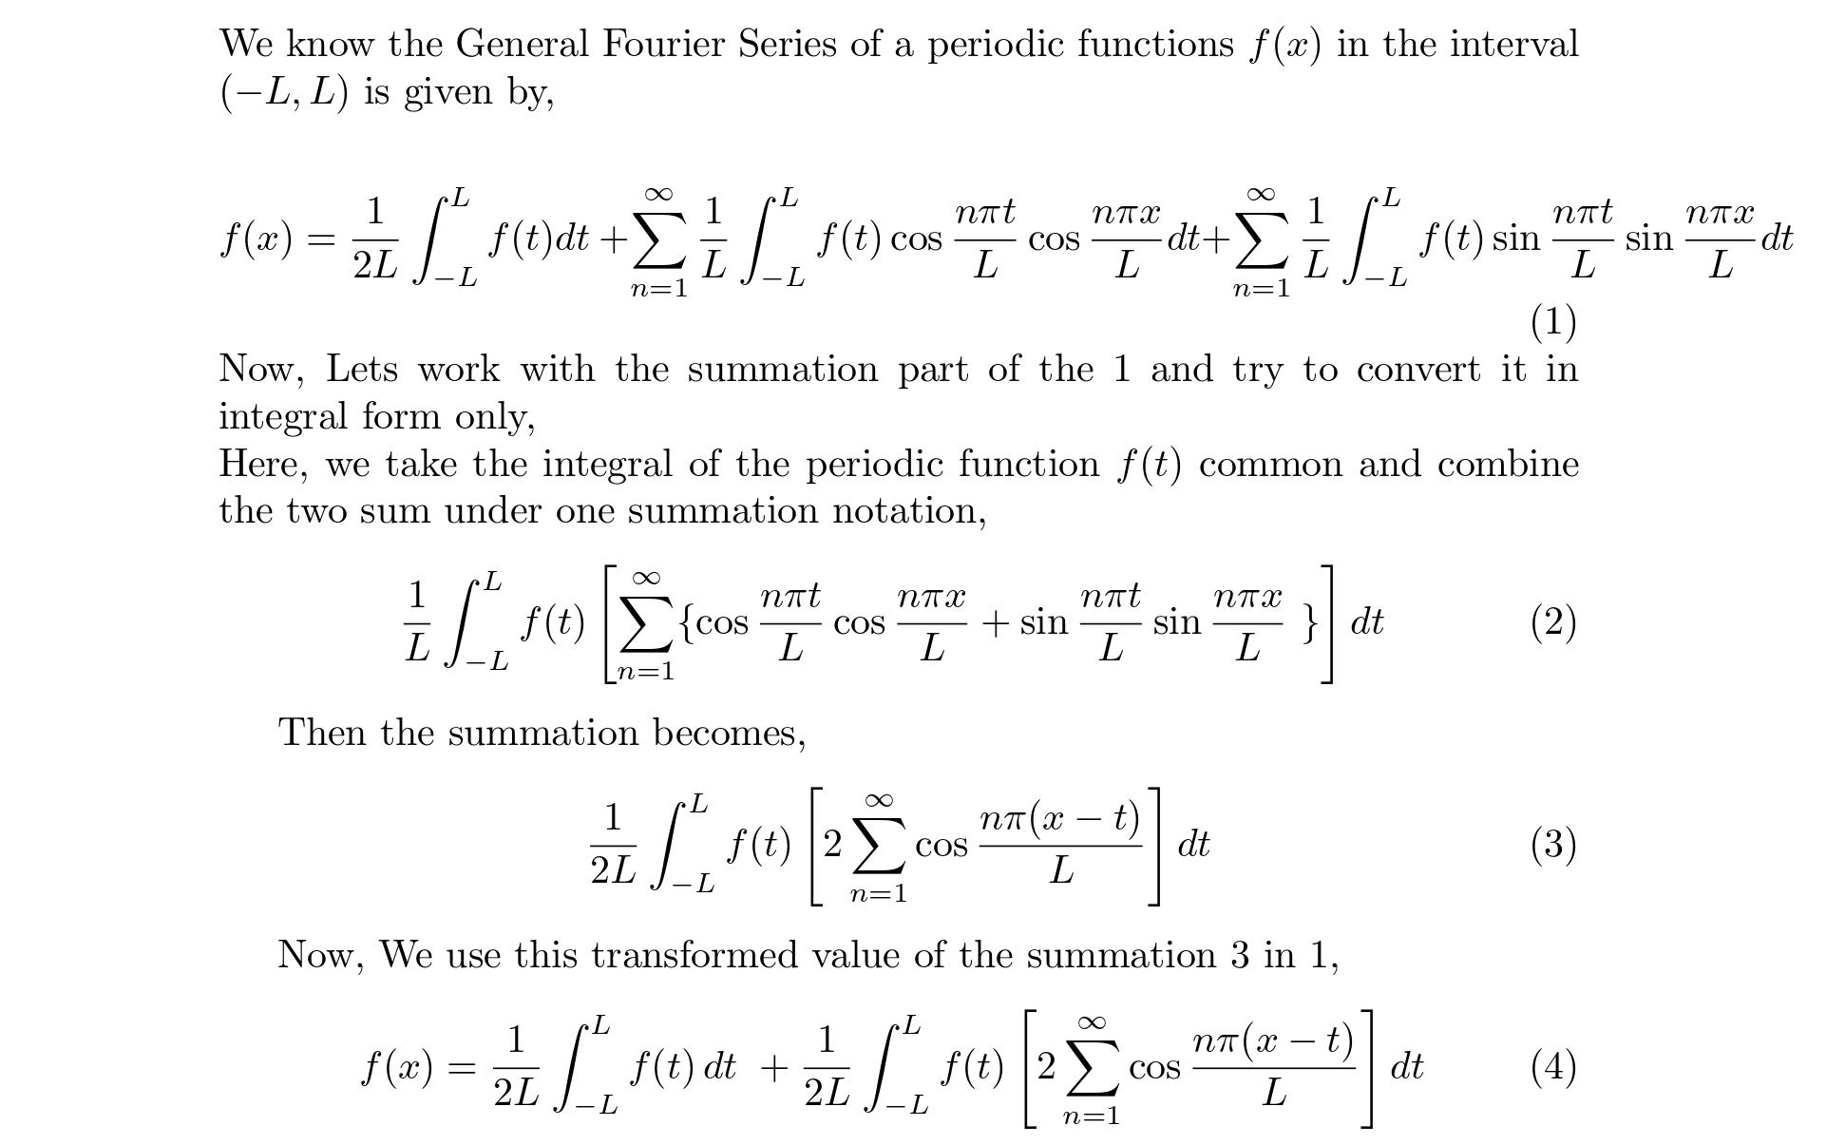

Slide 5
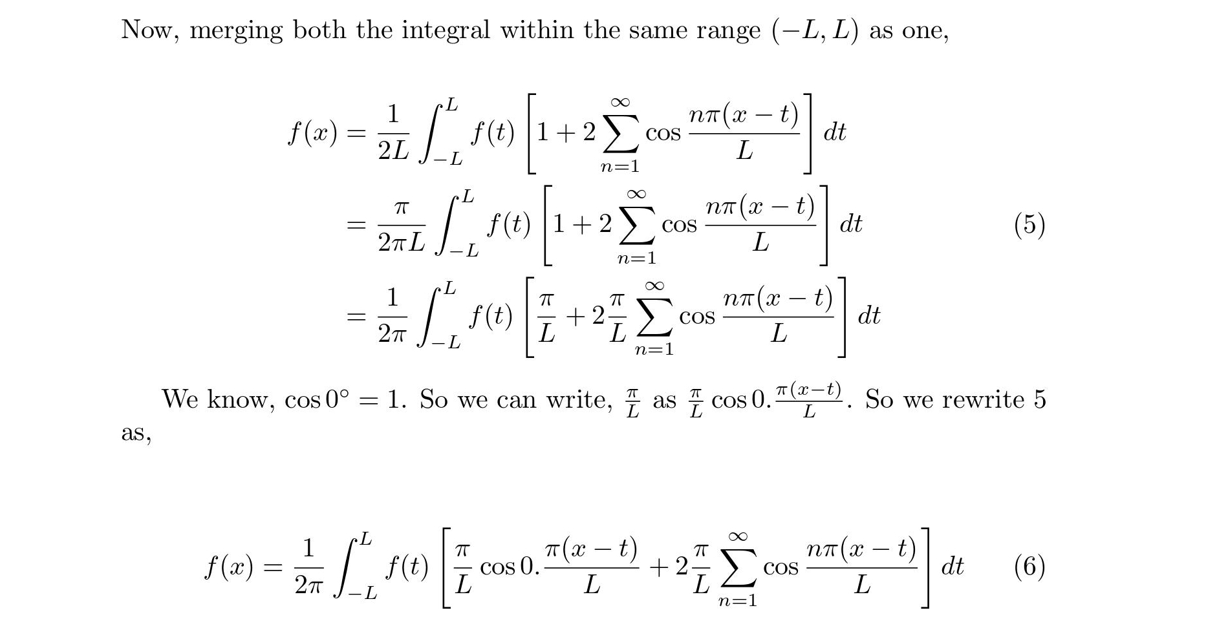

Slide 6
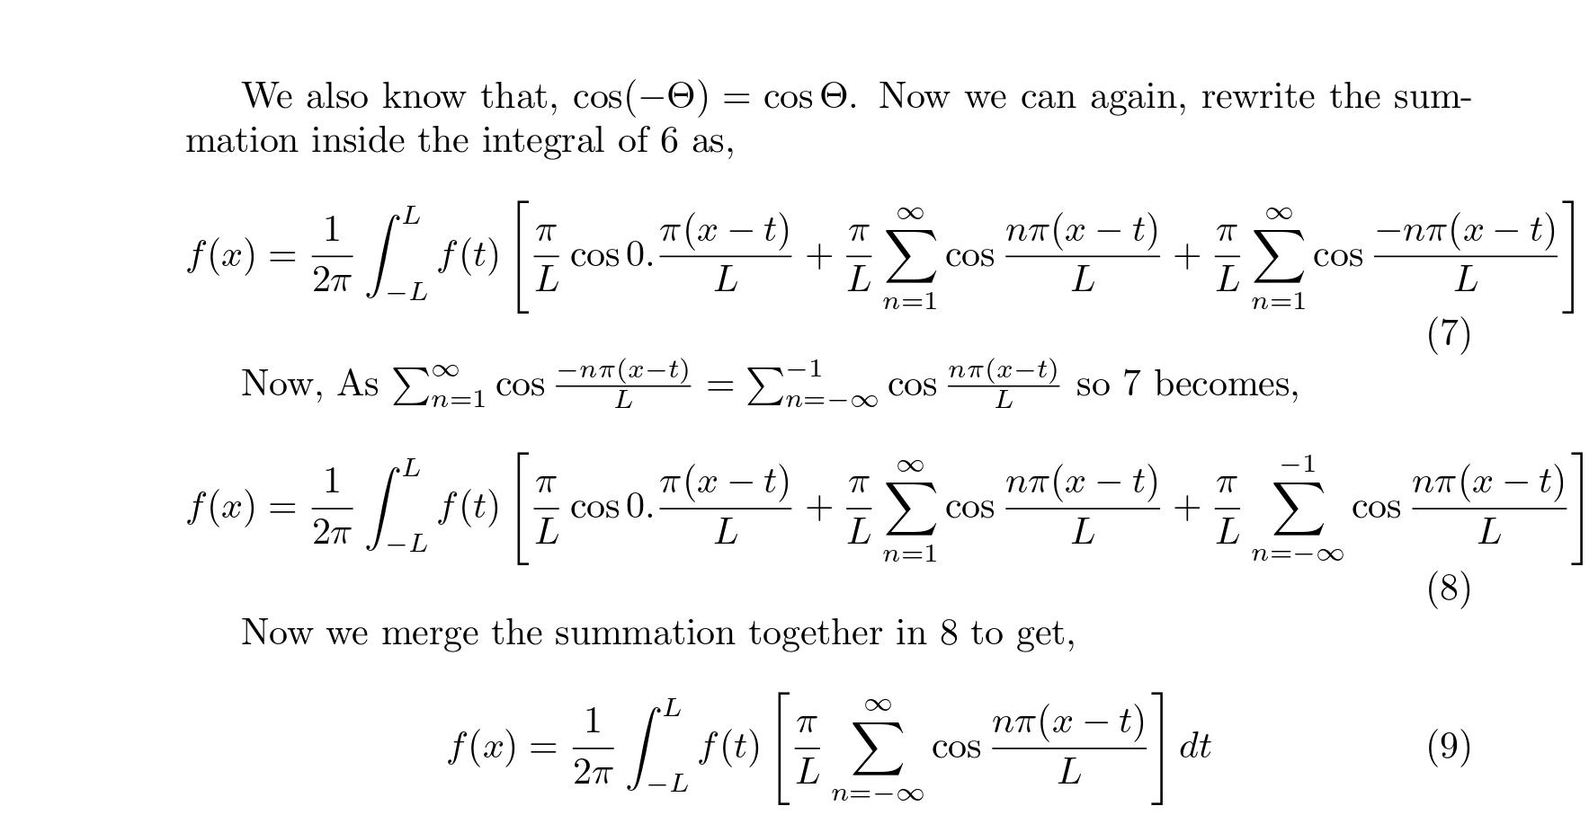

Slide 7
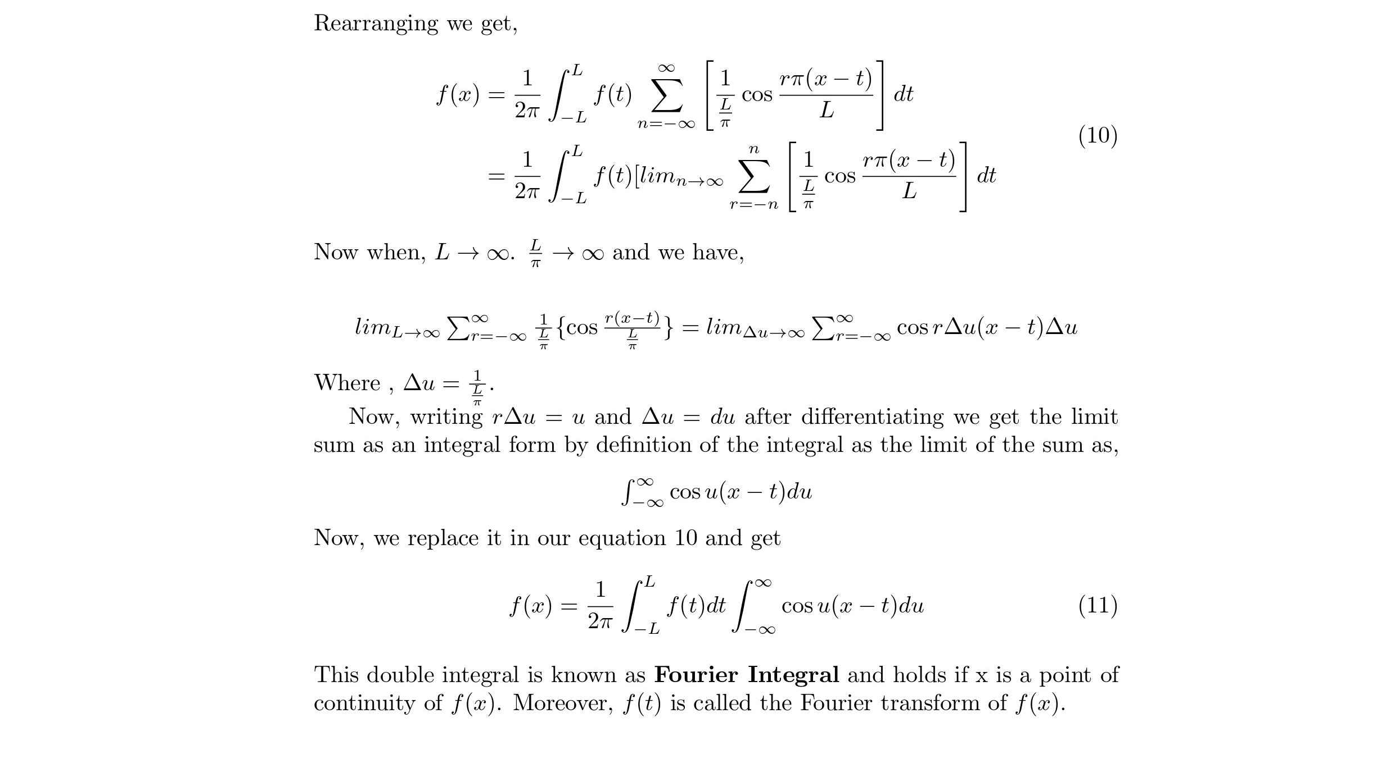

Slide 8
Section 2
Finite Fourier Sine and Cosine transform

Slide 9
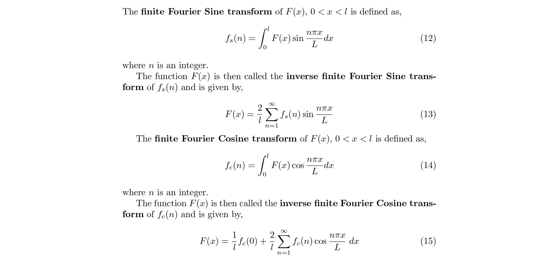

Slide 10
Section 3
Infinite Fourier Sine and Cosine transform

Slide 11
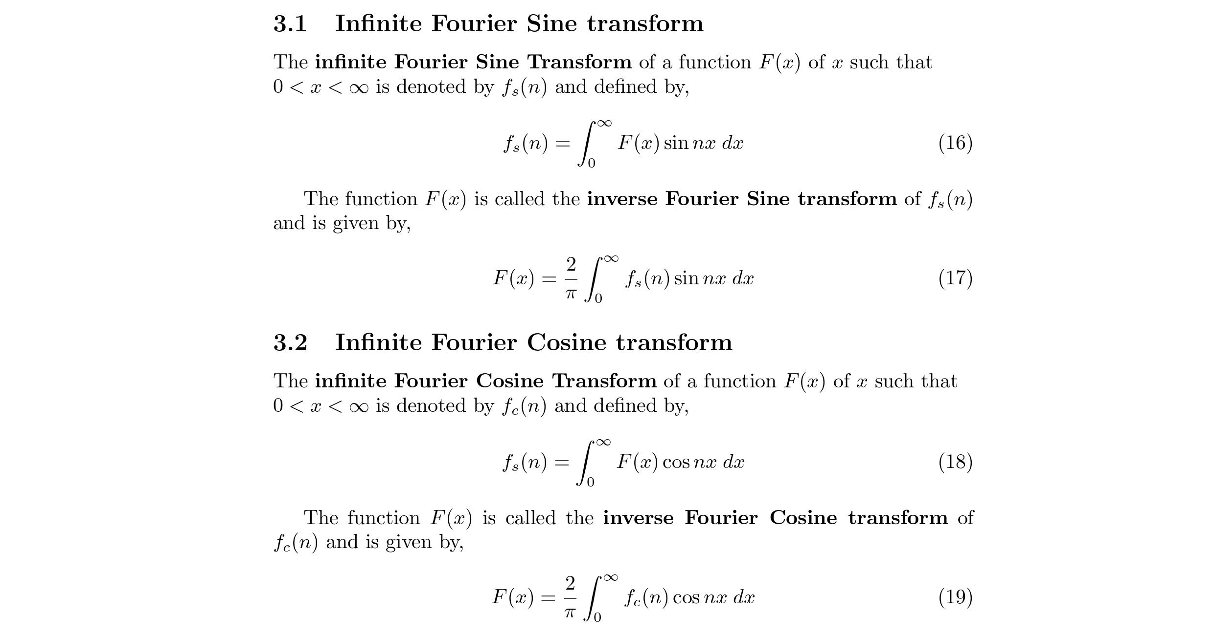

Slide 12
Section 4
Complex form of Fourier Integral and Fourier
transform

Slide 13


Slide 14
Section 5
Alternative form of Fourier transform

Slide 15
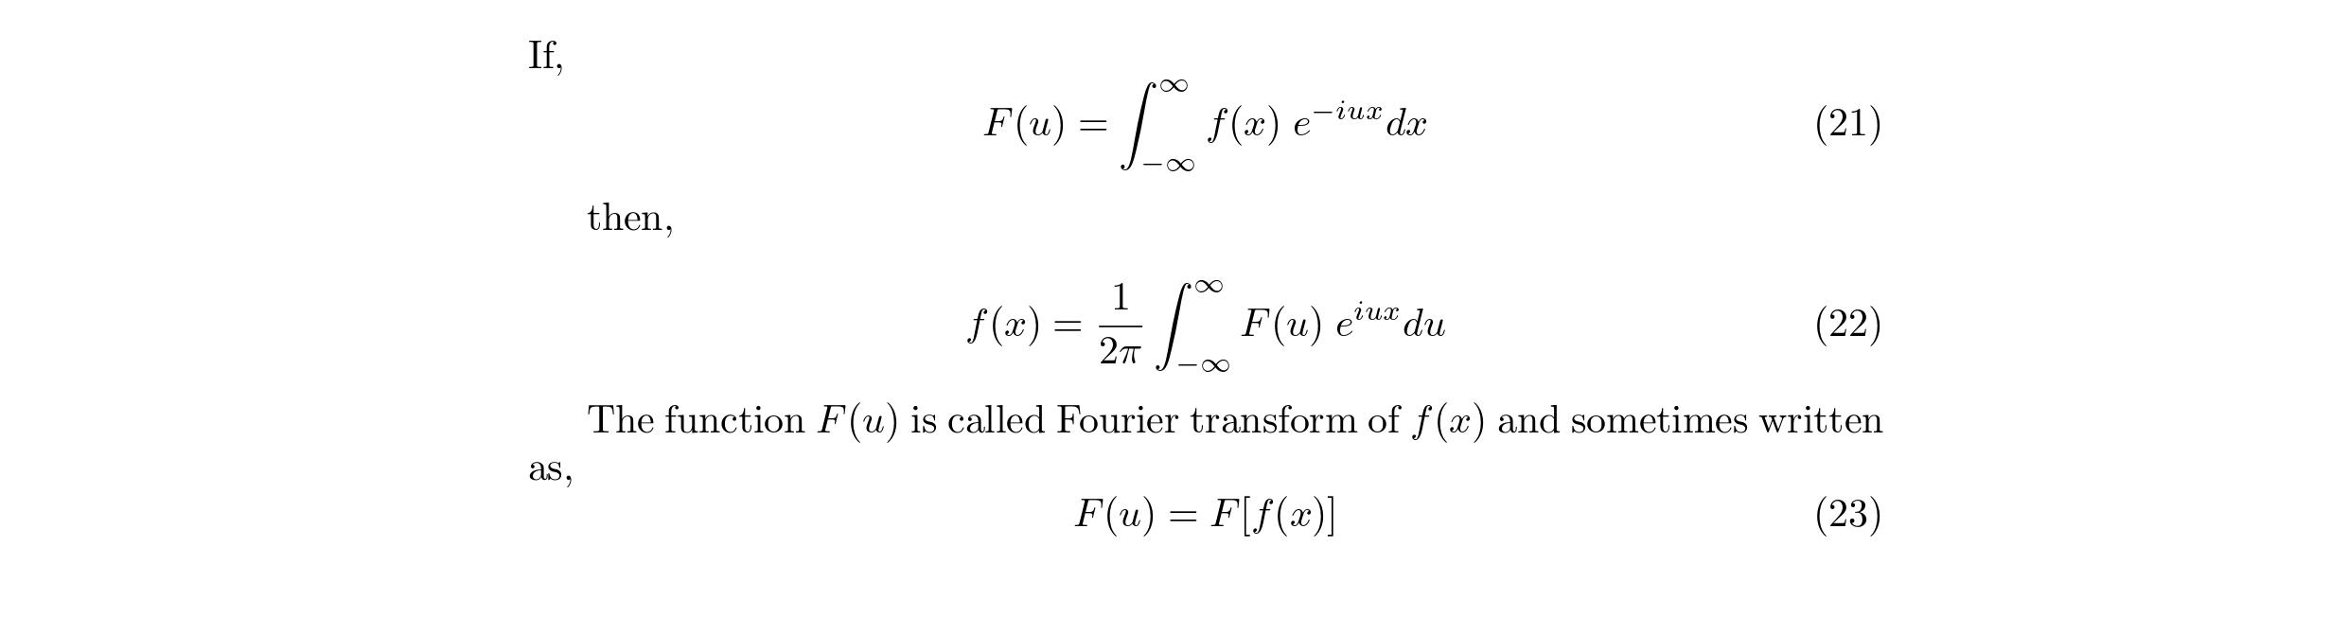

Slide 16
Section 6
Properties of Fourier transform

Slide 17
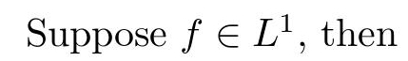
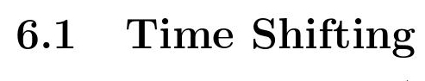
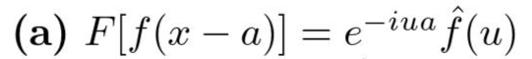
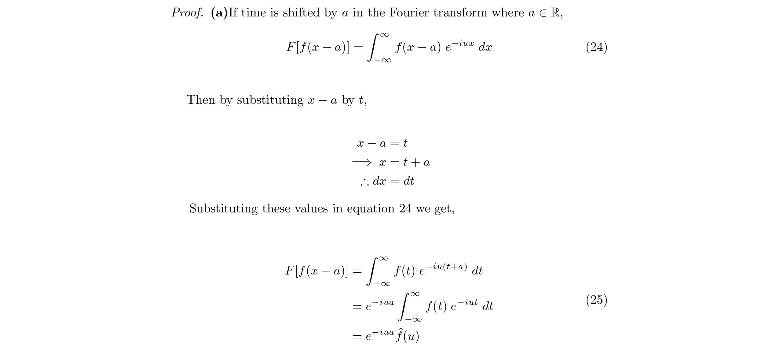

Slide 18
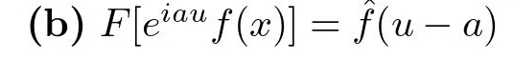


Slide 19
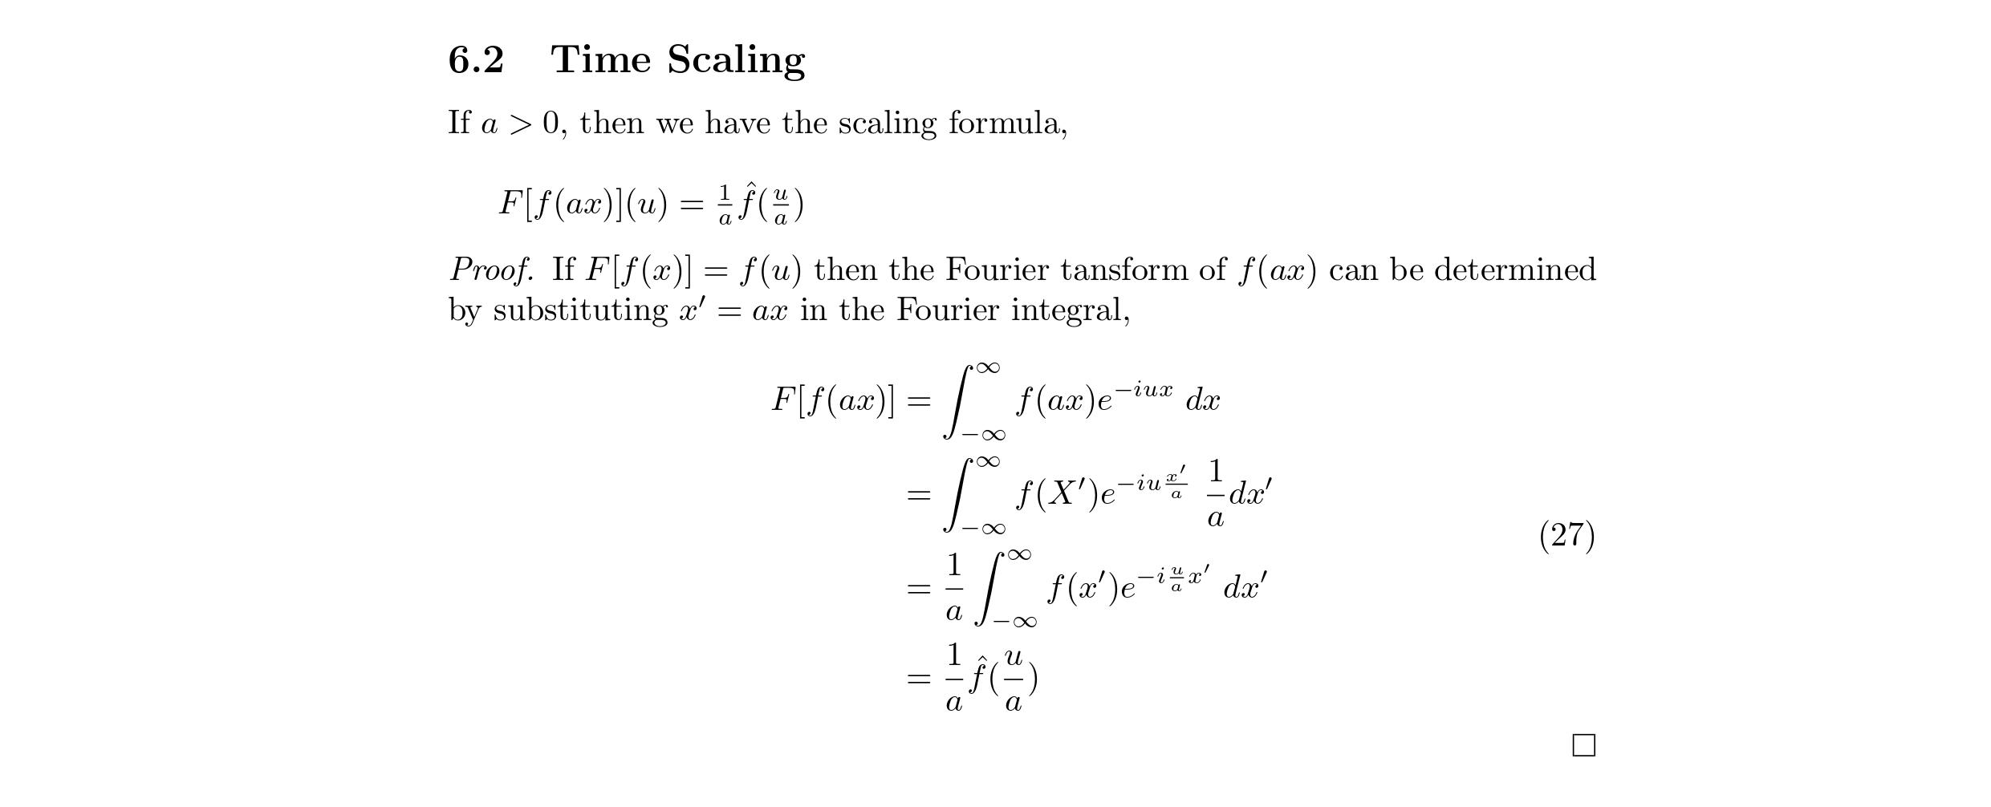

Slide 20
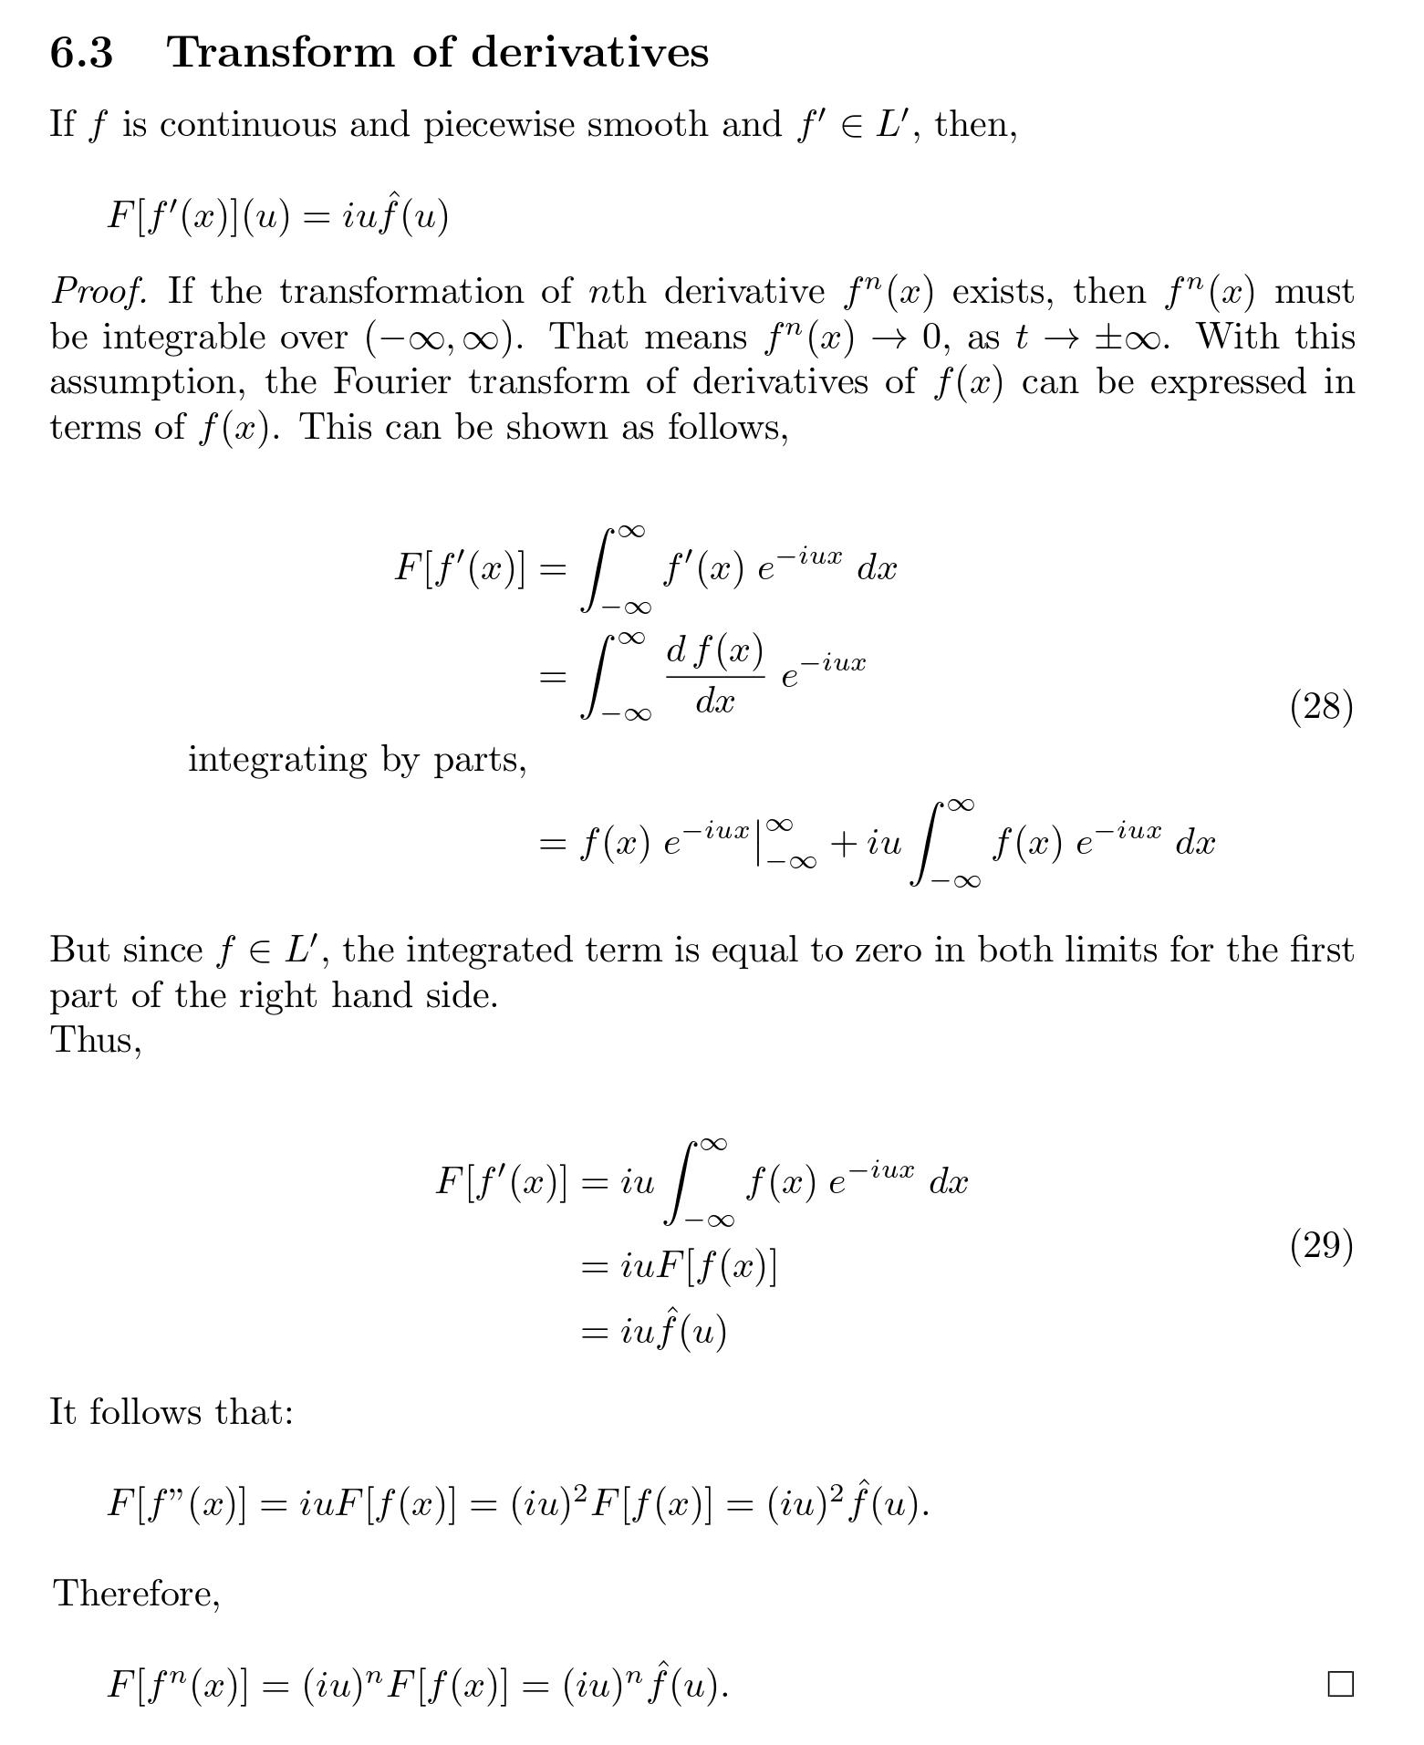

Slide 21
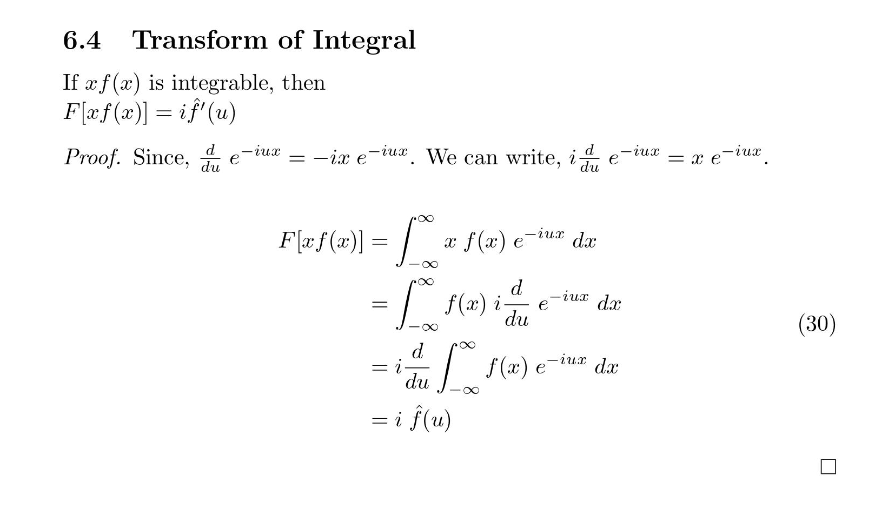

Slide 22
Questions??

